Slide 1
IERT: INSTITUTE OF ENGINEERING AND RURAL TECHNOLOGY
MINI PROJECT PRESENTATION
PRESENTED BY :
UJJAWAL MALVIYA
COMPUTER SCIENCE & ENGINEERING
2101100100061
TOPIC : RAILWAY RESERVATION SYSTEM

Slide 2
OVERVIEW
Introduction
Objective
Experimental analysis
Experimental result
Conclusion
Acknowledgement

Slide 3
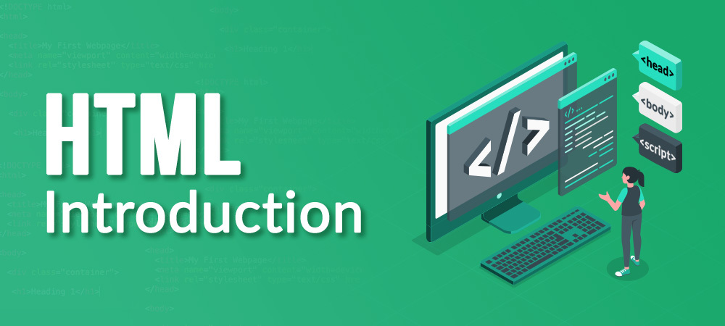
INTRODUCTION:
HTML(HYPER TEXT MARKUP LANGUAGE)
HTML is the standard markup language for creating Web pages.
What is HTML?
HTML stands for Hyper Text Markup Language
HTML is the standard markup language for creating Web pages
HTML describes the structure of a Web page
HTML consists of a series of elements
HTML elements tell the browser how to display the content
HTML elements label pieces of content such as "this is a heading", "this is a paragraph", "this is a link", etc.

Slide 4
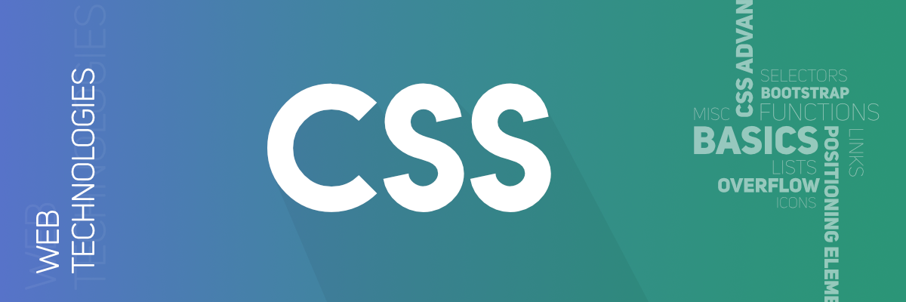
CSS(cascading style sheets):
Cascading Style Sheets, fondly referred to as CSS, is a simply designed
language intended to simplify the process of making web pages presentable.
CSS allows you to apply styles to web pages
Why CSS?
CSS saves time: You can write CSS once and reuse the same sheet in multiple HTML pages.
Easy Maintenance: To make a global change simply change the style, and all elements in all the webpages
will be updated automatically.
Search Engines: CSS is considered a clean coding technique, which means search engines won’t have to
struggle to “read” its content.
Superior styles to HTML: CSS has a much wider array of attributes than HTML

Slide 5
PHP(HYPERTEXT PREPROCESSOR):
PHP is an acronym for "PHP: Hypertext Preprocessor"
PHP is a widely-used, open source scripting language
PHP scripts are executed on the server
PHP is free to download and use
What Can PHP Do?
PHP can generate dynamic page content
PHP can create, open, read, write, delete, and close files on the server
PHP can collect form data
PHP can send and receive cookies
PHP can add, delete, modify data in your database

Slide 6
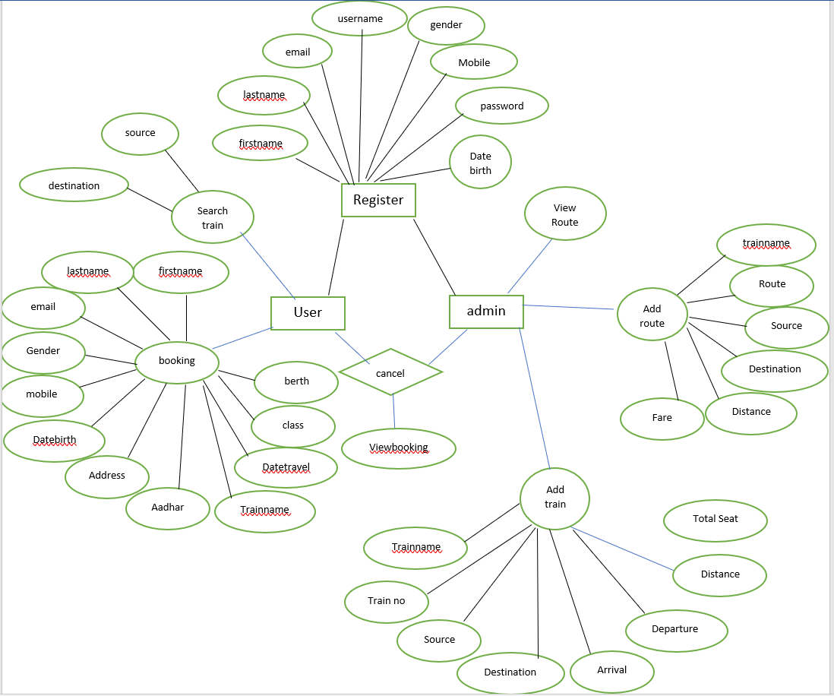
DBMS(DATABASE MANAGEMENT SYSTEM)
A Database Management System (DBMS) is a software system that is designed to manage and organize data in a
structured manner. It allows users to create, modify, and query a database, as well as manage the security and
access controls for that database.

Slide 7
OBJECTIVE :
Searching of data is easy.
Passenger don’t have to wait for a long time.
Information is accurate.
It is a fast process.
Data efficient is more.

Slide 8
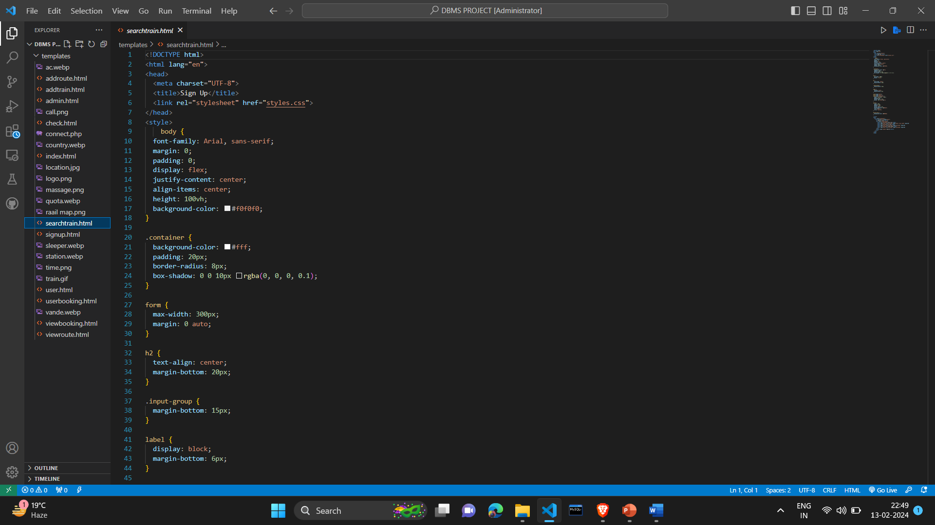
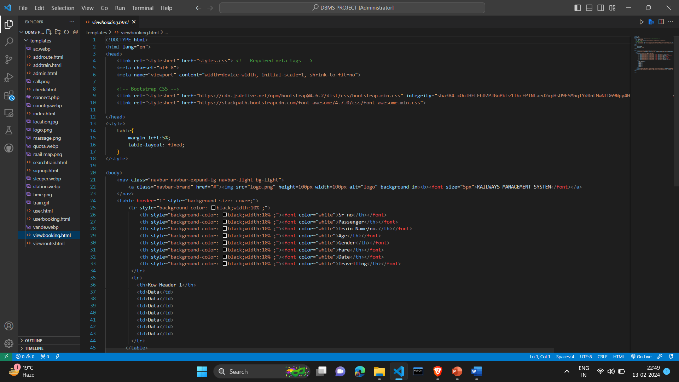
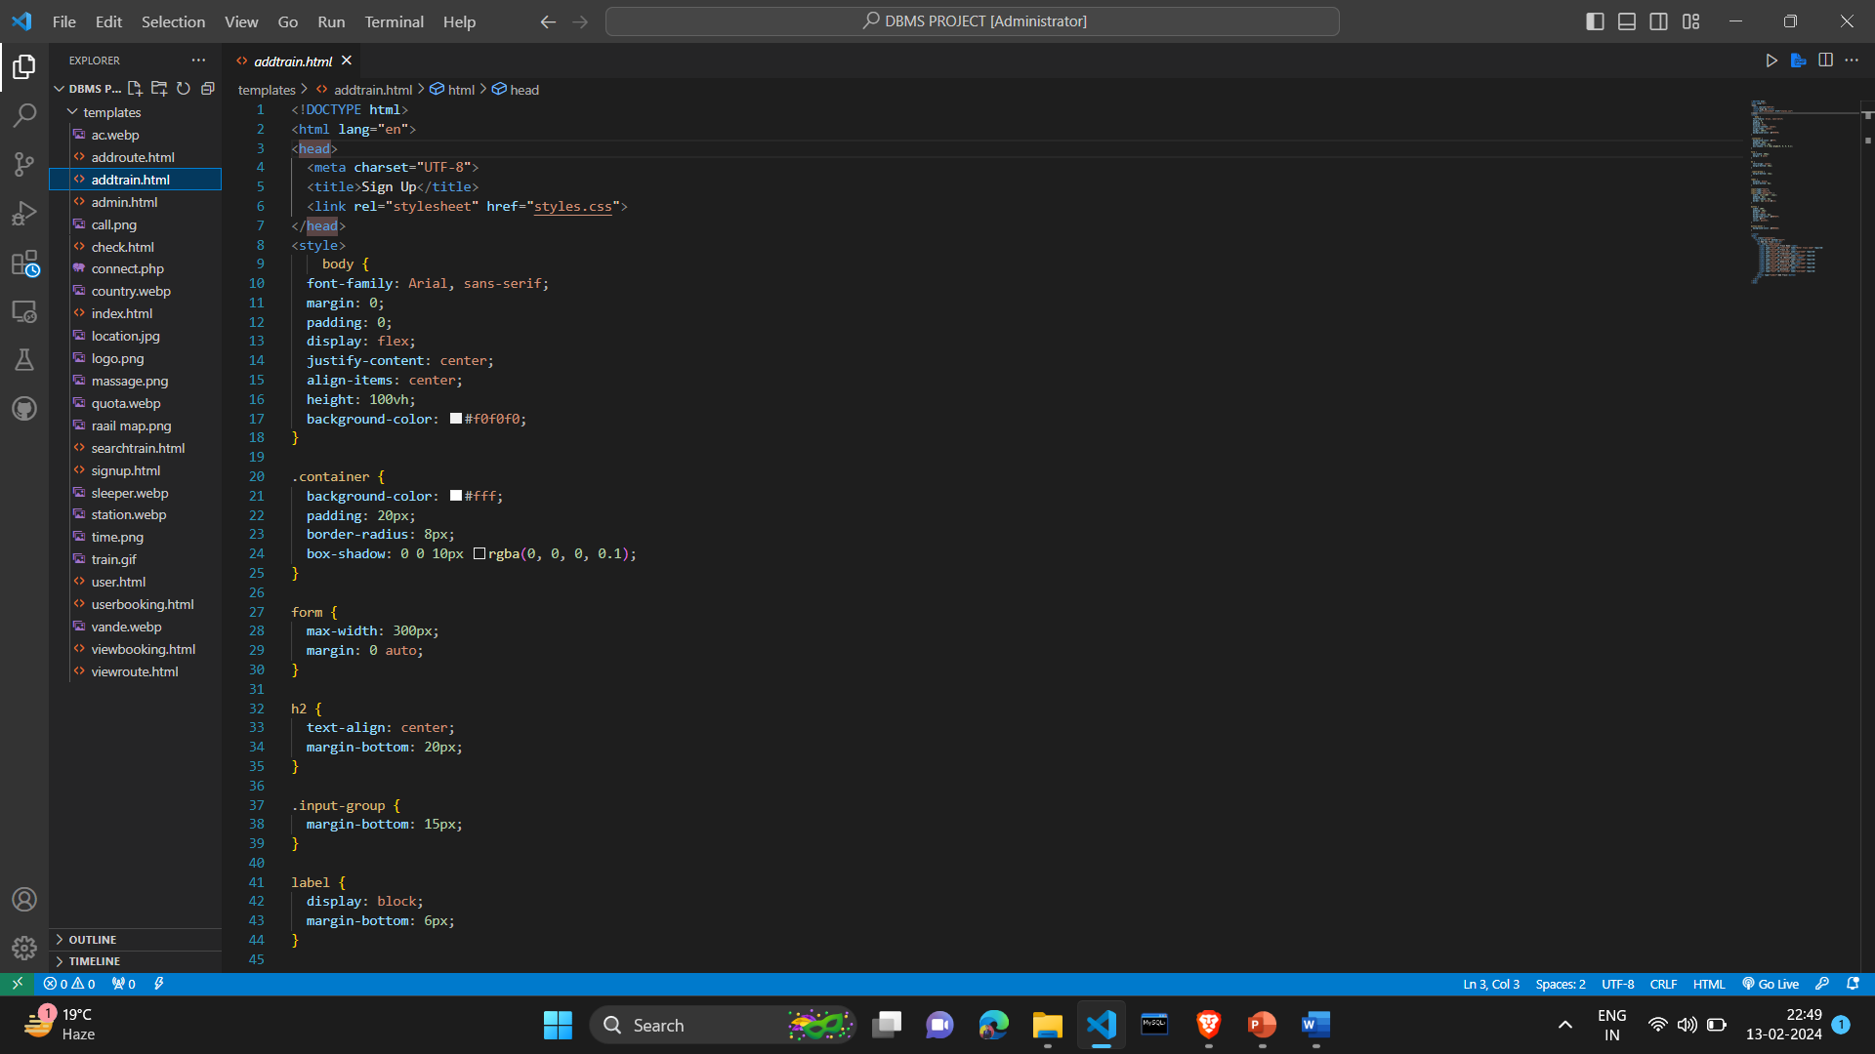
EXPERIMENTAL ANALYSIS:

Slide 9
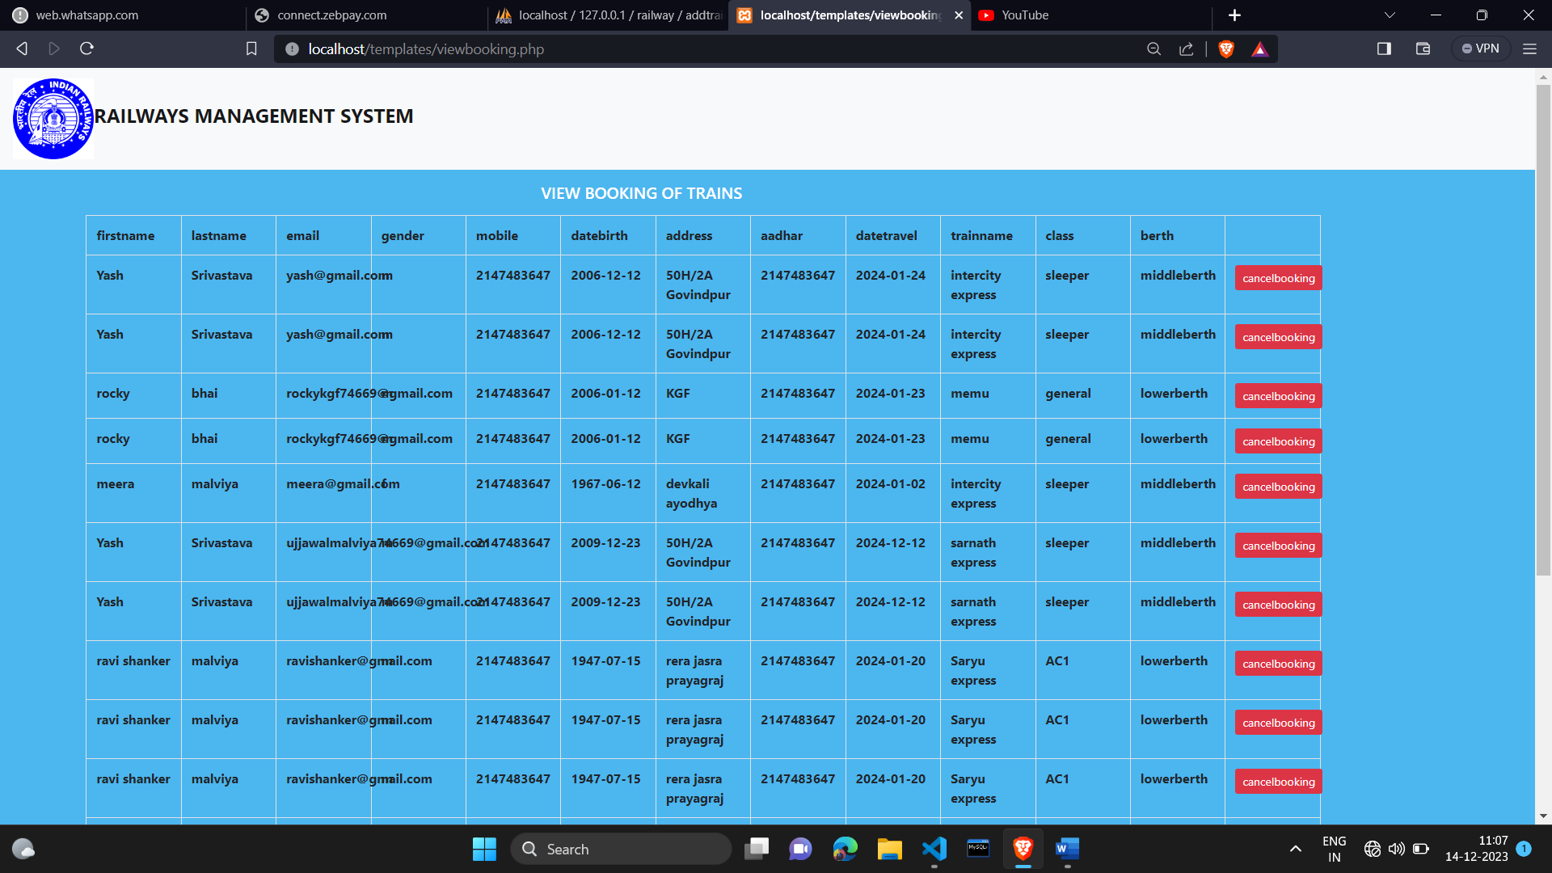
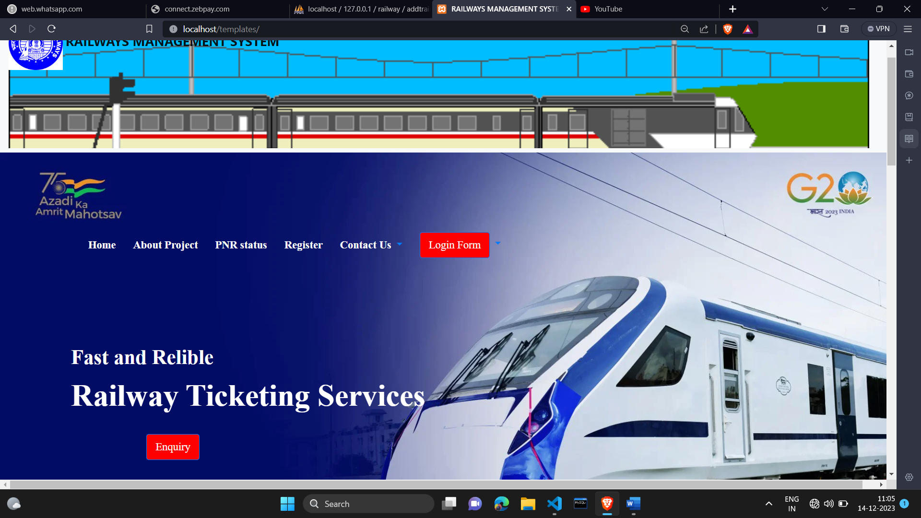
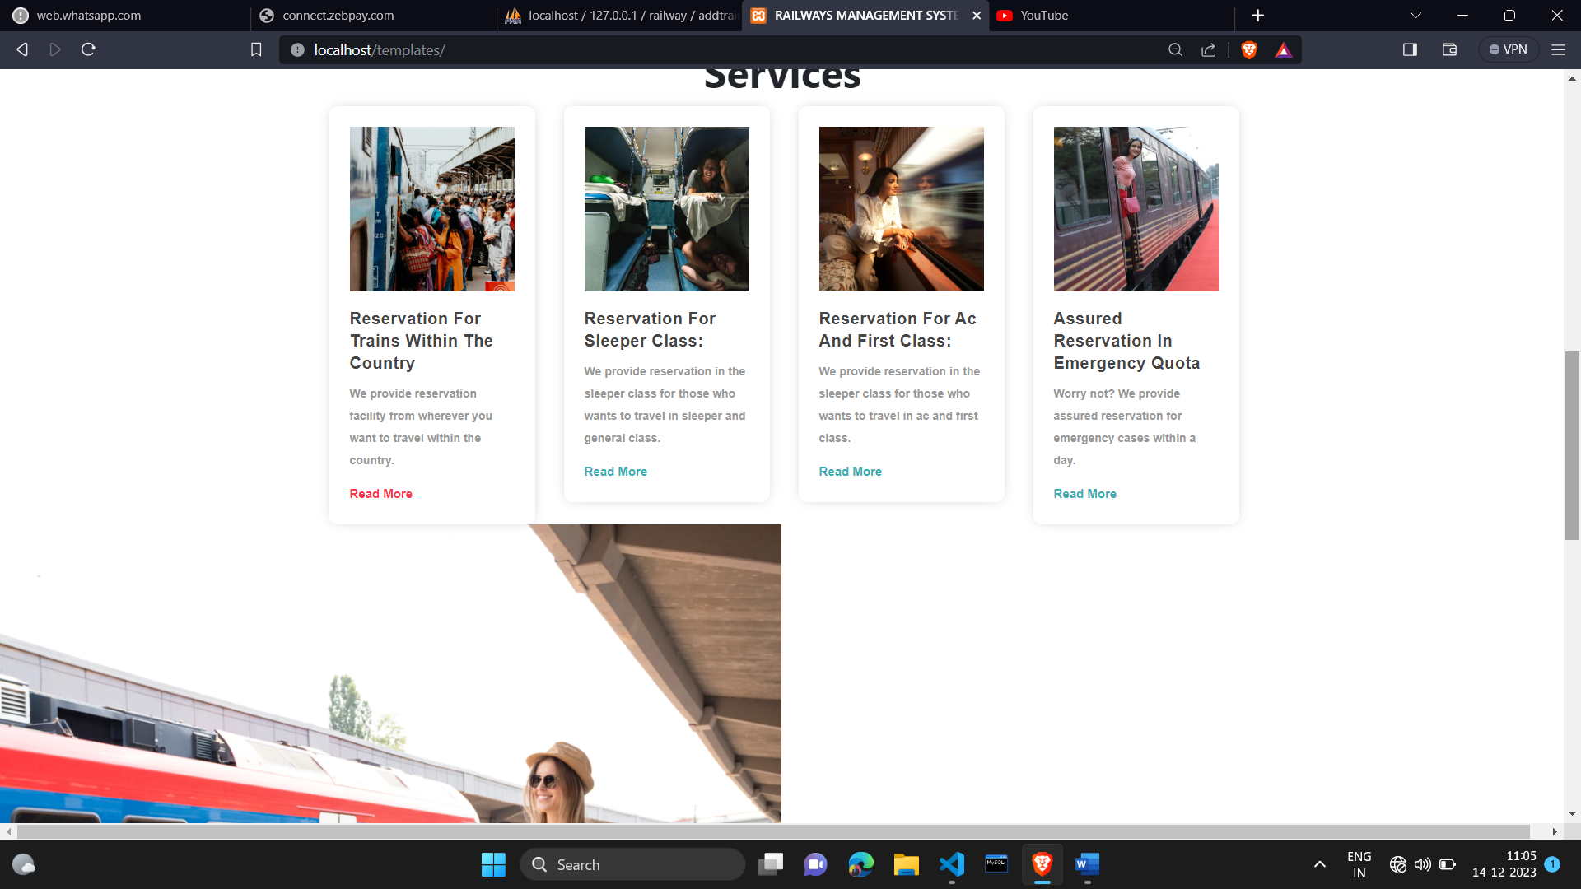
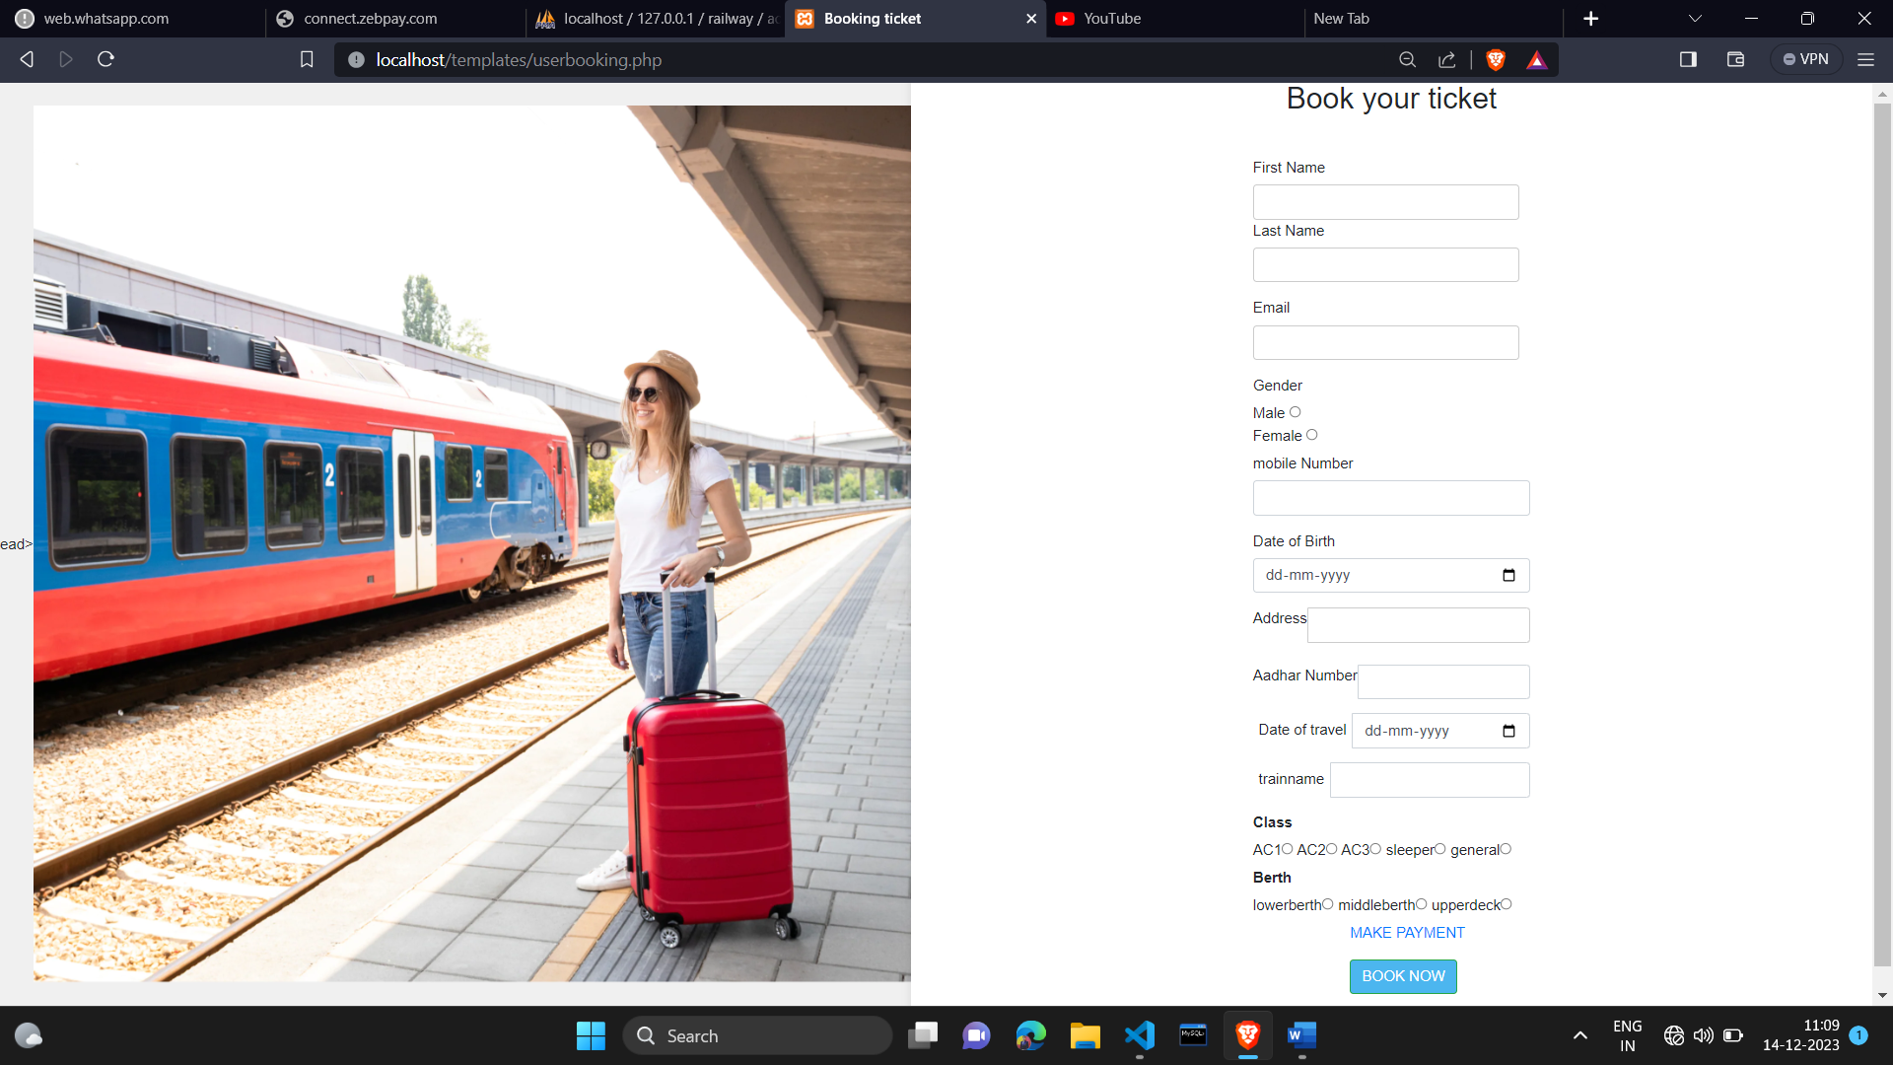
EXPERIMENTAL RESULTS:

Slide 10
CONCLUSION:
In our project railways reservation system we have stored all the information about the train schedule and the
user booking tickets even status of train ,seat etc .This database is helpful for the application which is facilitates
passengers to book the trains tickets and check the details of train and their status from their place itself it avoid
inconviniences of going to the railways station for each and every query they got . we had considered the most
important requirements only,many more features and details.
We added to our project in order to obtain even more user friendly application. These application are
already in progress and in future they can be upgraded and may become part of amazing technology.

Slide 11
ACKNOWLEDGEMENT
I would like to express my sincerest gratitude to all those who have supported, encouraged, and helped me in completing this
project. It has been a long and arduous journey, and I am deeply grateful for the help and support of everyone mentioned below.
First and foremost, I would like to thank my project mentor “Mr.Indubhusan Dubey”sir & HOD of Department of Computer
science “Mr.Rohit Gupta” sir, for their unwavering support and guidance throughout this project. Their expertise and keen eye
have been invaluable in helping me to put together an impressive and comprehensive project. I am also thankful for their
ongoing advice and feedback, which were essential in the completion of this project.
Ujjawal Malviya
Roll No.:- 2101100100061
CSE Department
IERT ,Prayagraj

Slide 12
Thank You !

